Slide 1
Bayesian Neural Model Selection
for Symmetry Learning
Tycho van der Ouderaa @ JSM 2024 in Portland, US

Slide 2
What is Bayesian model selection?
How to scale to deep neural networks
Learning inductive bias and symmetries

Slide 3
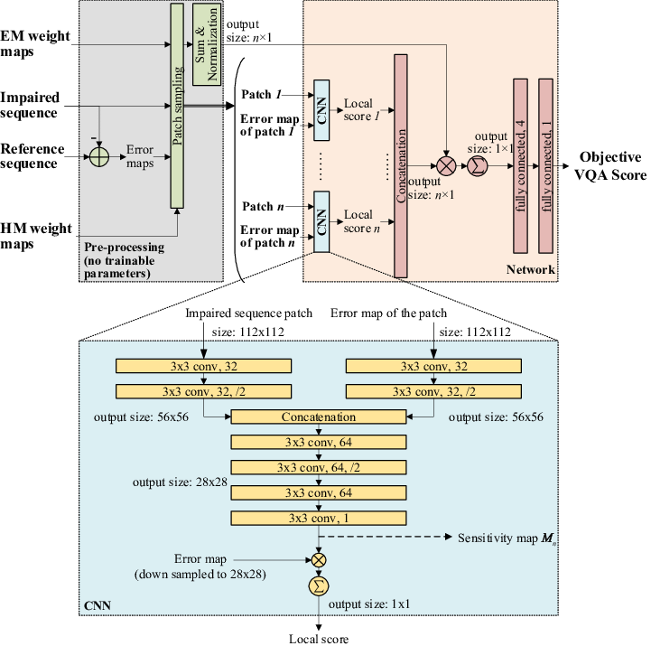
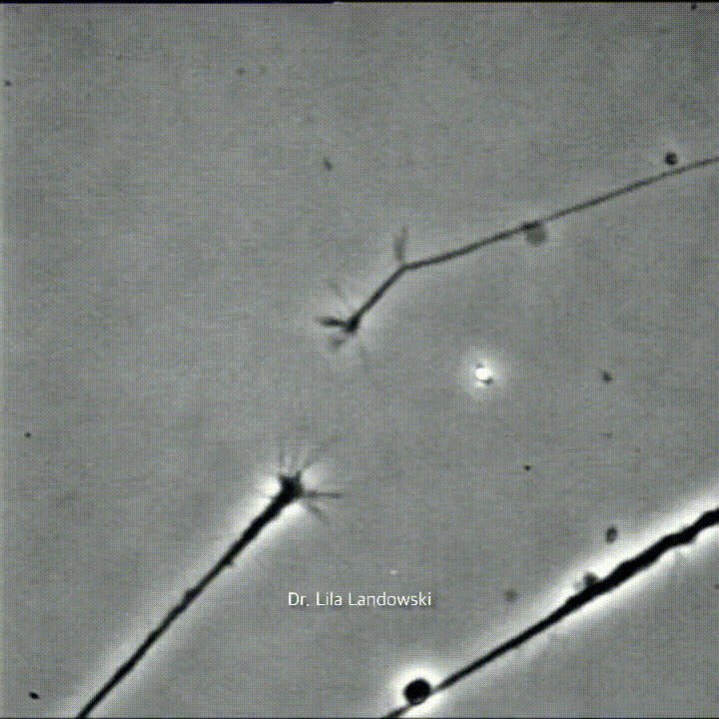
Future vision of ML
Architectures determined by
trial-and-error
Morphable architectures
automatic inductive bias
Bayesian model selection
References:
Left: Bridge the Gap Between VQA and Human Behavior on Omnidirectional Video: A Large-Scale Dataset and a Deep Learning Model, Chen Li, Mai Xu, Xinzhe Du, Zulin Wang
Right video:"Neurons connecting to one another in a Petri dish - growth cones." by Dr Lila Landowski

Slide 4

Future vision of ML
Architectures determined by
trial-and-error
Morphable architectures
automatic inductive bias
Bayesian model selection
References:
Left: Bridge the Gap Between VQA and Human Behavior on Omnidirectional Video: A Large-Scale Dataset and a Deep Learning Model, Chen Li, Mai Xu, Xinzhe Du, Zulin Wang
Right video:"Neurons connecting to one another in a Petri dish - growth cones." by Dr Lila Landowski Right picture: Wells, R. (Producer), Clements, R., & Musker, J. (Directors). (2002). Treasure Planet [Film]. Walt Disney Pictures.

Slide 5

Fitting a neural network

Slide 6


Regular training (maximum likelihood / MAP)
Likelihood:
Prior:

Slide 7

Regular training (maximum likelihood / MAP)
Likelihood:
Prior:
Posterior:

Slide 8

Regular training (maximum likelihood / MAP)
Likelihood:
Prior:
Posterior:
Optimal
Regular loss

Slide 9



Supervised training (maximum likelihood / MAP)
Likelihood:
Prior:
Posterior:
Optimal

Slide 10
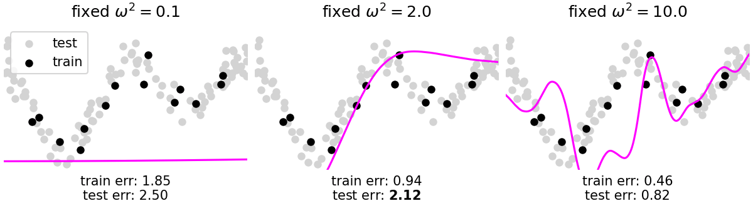
Bayesian model selection
Regular training (maximum likelihood)

Slide 11
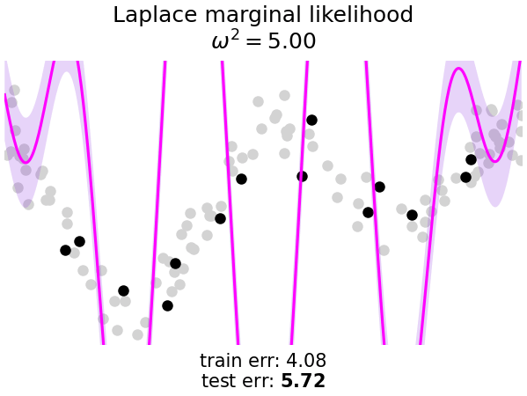
Bayesian model selection
Regular training (maximum likelihood)
Bayesian model selection (marginal likelihood)
Uses gradients. No expensive cross-validation

Slide 12
Learn how to generalize

Slide 13

Bayesian model selection (marginal likelihood)

Slide 14

Bayesian model selection (marginal likelihood)
Marginal likelihood

Slide 15

Bayesian model selection (marginal likelihood)
Marginal likelihood
Optimise
[Type-II ML / Empirical Bayes]
Allows optimization of architecture/inductive bias with gradients!

Slide 16
How to integrate out neural network parameters?

Slide 17


Gaussian approximation
Approximate posterior with a Gaussian
How to find and ?

Slide 18


Approximate Bayesian inference
Laplace approximation
Variational Inference

Slide 19
Approximate Bayesian inference
Laplace approximation
Variational Inference
(local)
(global)
Pretrained network + Hessian
Optimize ELBO objective

Slide 20


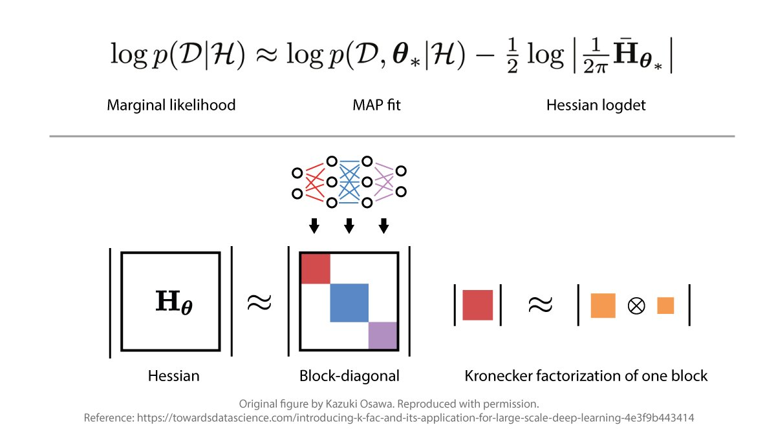


Only correlate rows and columns
Independence between layers
Independence between inputs and outputs
KFAC Hessian approximation:

Slide 21


Approximate Bayesian inference
Laplace approximation
Variational Inference
[1, 2]
[3]
[1] Optimizing Neural Networks with Kronecker-factored Approximate Curvature James Martens and Roger Grosse In ICML 2016
[2] Scalable Marginal Likelihood Estimation for Model Selection in Deep Learning Alexander Immer,Matthias Bauer, Vincent Fortuin, Gunnar Ratsch, Mohammad Emtiyaz Khan In ICML 2021 [3] Structured and efficient variational deep learning with matrix gaussian posteriors Christos Louizos and Max Welling In ICML 2016

Slide 22

Approximate Bayesian inference
Laplace approximation
Variational Inference
Tricks of the trade:
Easy inverse / determinant (Kronecker identities in Laplace [1,2], Cholesky parameterization in VI as App. D in [13] )
Use mini-batches (easy in VI, requires care in Laplace [4] )
Account for weight-symmetries (with correction in KL term [5] )
Optimize prior variance and output variance empirically ( [2], closed-form VI updates in App. D of [13] )
[4] Stochastic Marginal Likelihood Gradients using Neural Tangent Kernels Alexander Immer, Tycho F.A. van der Ouderaa, Mark van der Wilk, Gunnar Ratsch, Bernhard Schölkopf In ICML 2023 [5] Variational Inference Failures Under Model Symmetries: Permutation Invariant Posteriors for Bayesian Neural Networks Yoav Gelberg, Tycho F. A. van der Ouderaa, Mark van der Wilk, Yarin Gal In ICML 2024, GRaM workshop (best paper)

Slide 23
Laplace approximations at scale

Slide 24
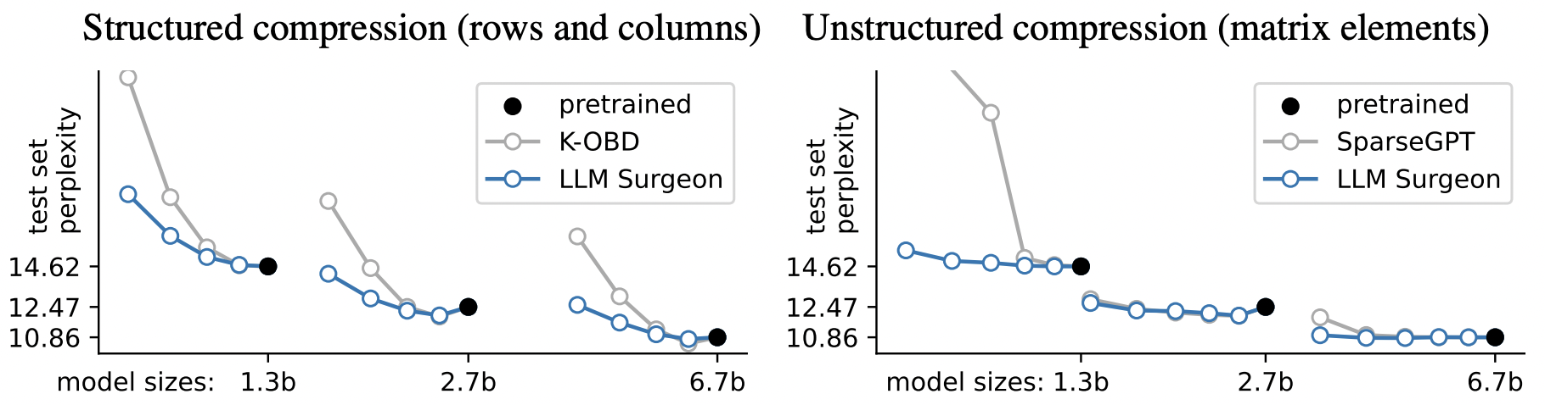
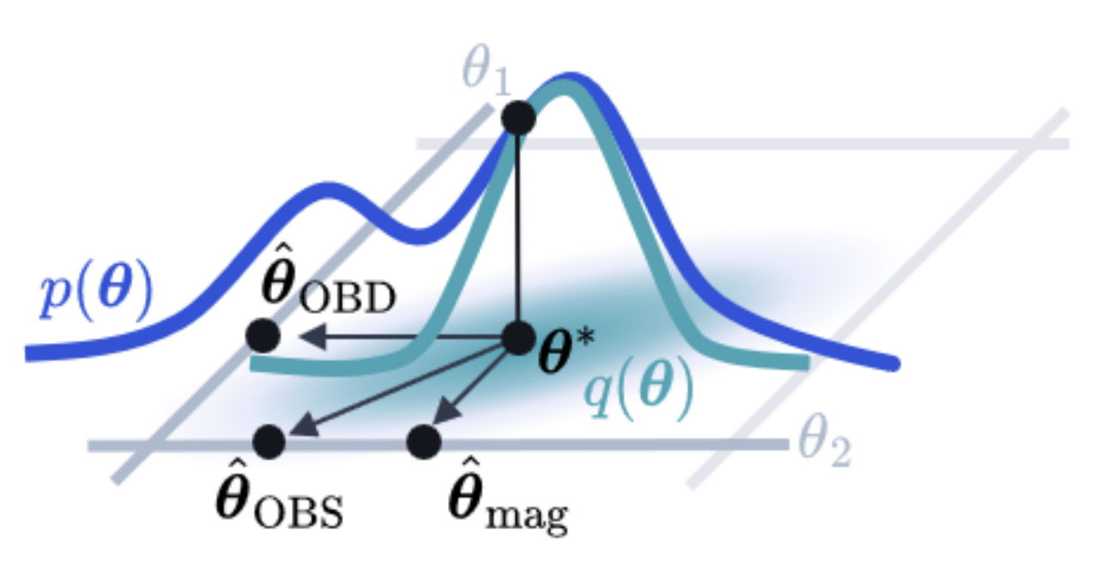
Laplace of networks with billions of parameters
Laplace can be applied to modern architectures [6]
State-of-the-art in structured LLM pruning [7]:
[6] Kronecker-Factored Approximate Curvature for Modern Neural Network Architectures Runa Eschenhagen, Alexander Immer, Richard E Turner, Frank Schneider, Philipp Hennig In NeurIPS 2023 [7] The LLM Surgeon Tycho F.A. van der Ouderaa, Markus Nagel, Mart van Baalen, Yuki M. Asano, Tijmen Blankevoort In ICLR 2024

Slide 25
Bayesian model selection
Regular training (maximum likelihood)
Bayesian model selection (marginal likelihood)

Slide 26
Inductive bias in deep learning

Slide 27
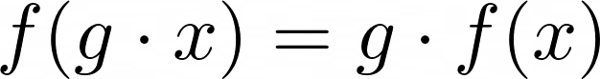
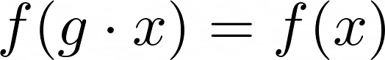
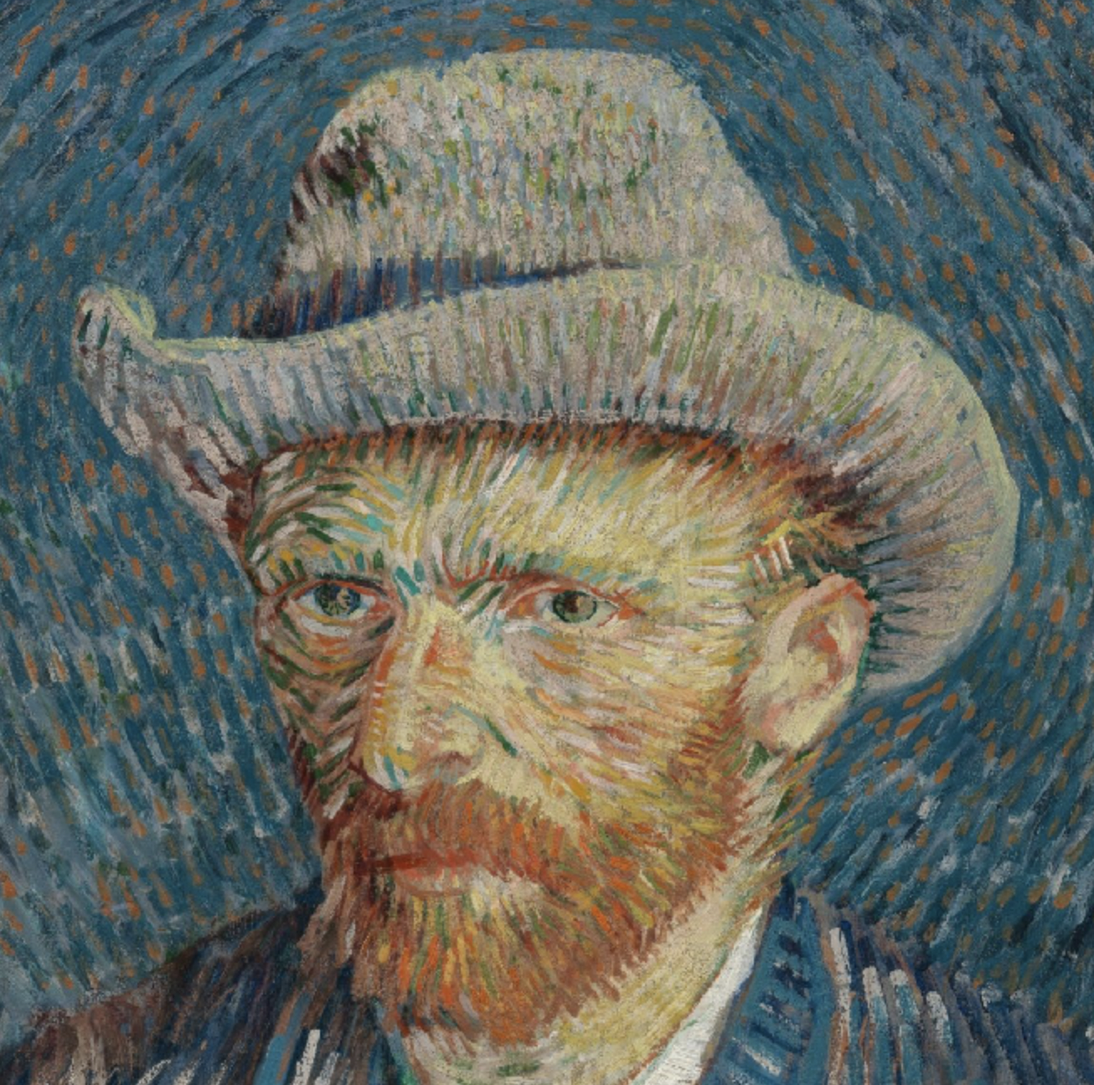
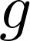
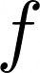
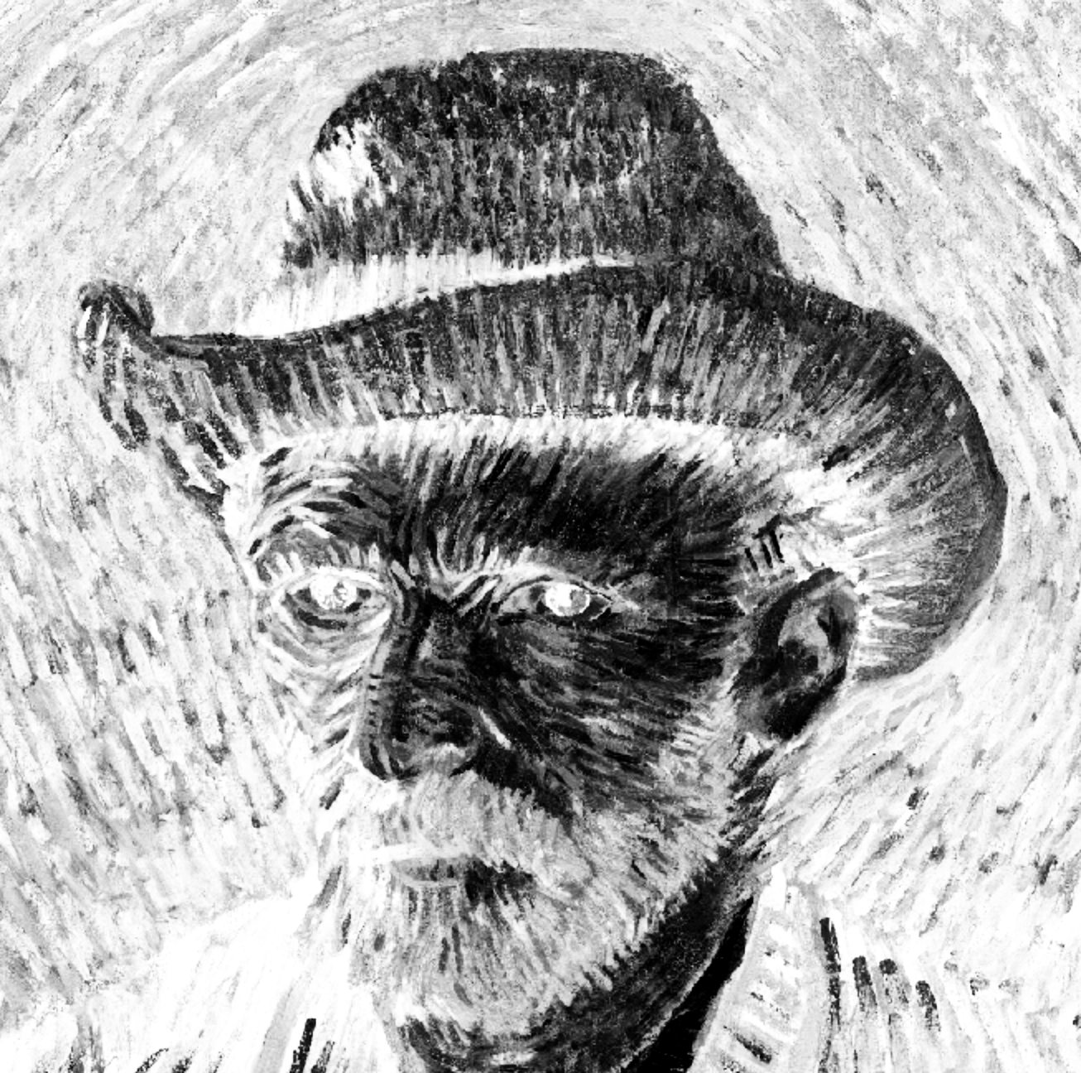
Equivariance
Invariance
Face
Face
Example image: Vincent van Gogh, Self-Portrait with Grey Felt Hat, 1887 Van Gogh Museum Amsterdam

Slide 28
Can we learn symmetries?

Slide 29
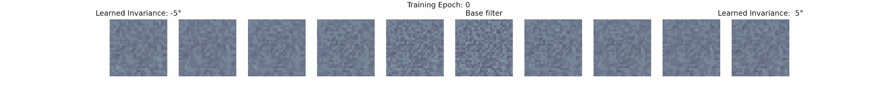
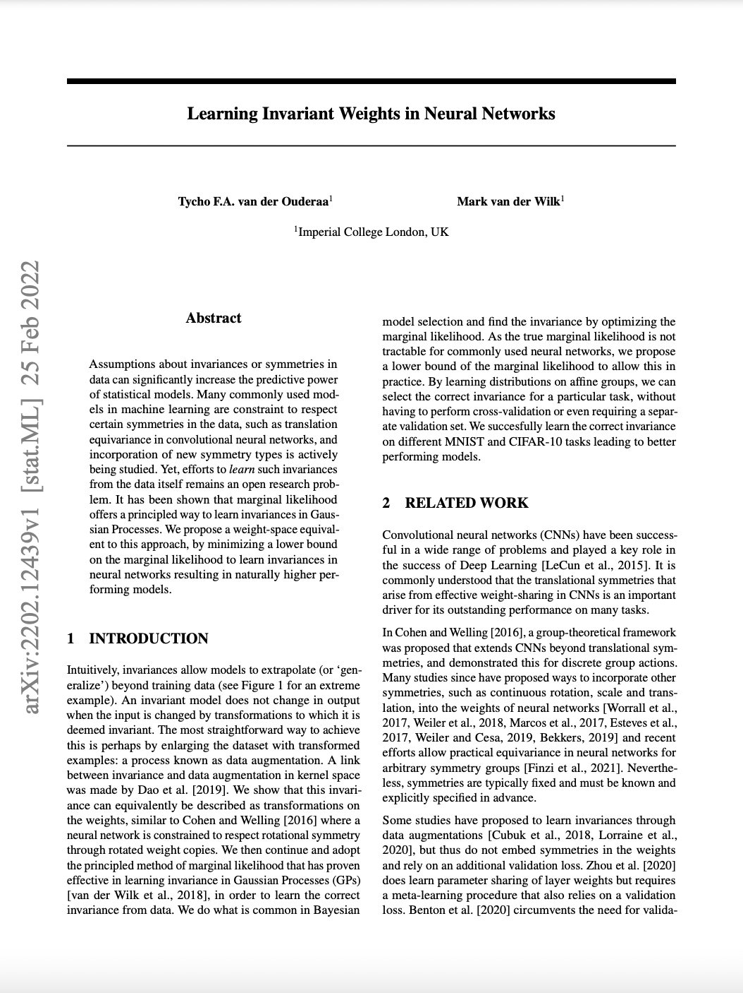
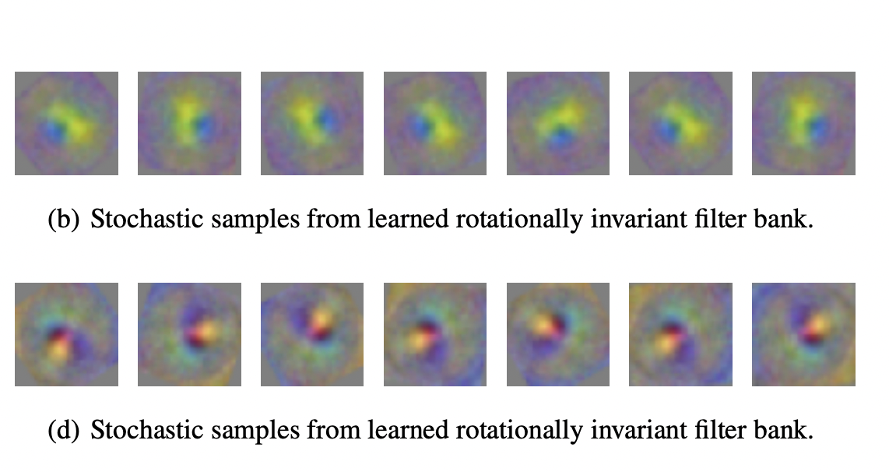
Learned filter bank on rotated MNIST:
Learned filter bank on rotated CIFAR-10:
[8] Learning Invariant Weights in Neural Networks Tycho F.A. van der Ouderaa and Mark van der Wilk In ICML 2021 (UDL Workshop) and UAI 2022 (Oral)

Slide 30
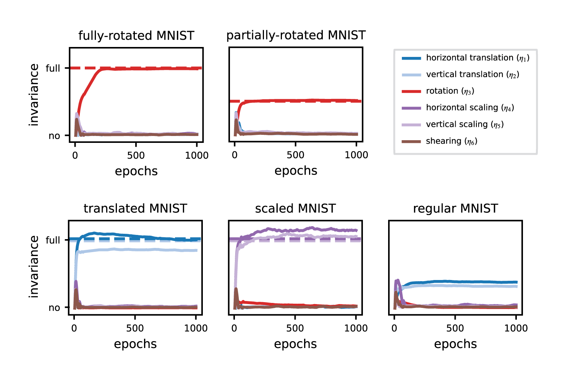
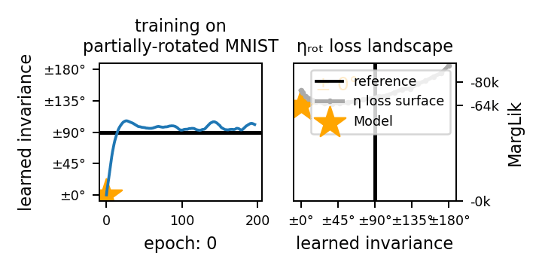
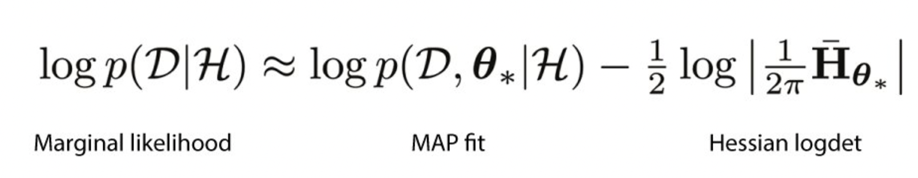
Invariance Learning in Deep Nets
[9] Invariance Learning in Deep Neural Networks with Differentiable Laplace Approximations Alexander Immer*, Tycho F.A. van der Ouderaa*, Vincent Fortuin, Gunnar Rätsch and Mark van der Wilk In NeurIPS 2022

Slide 31
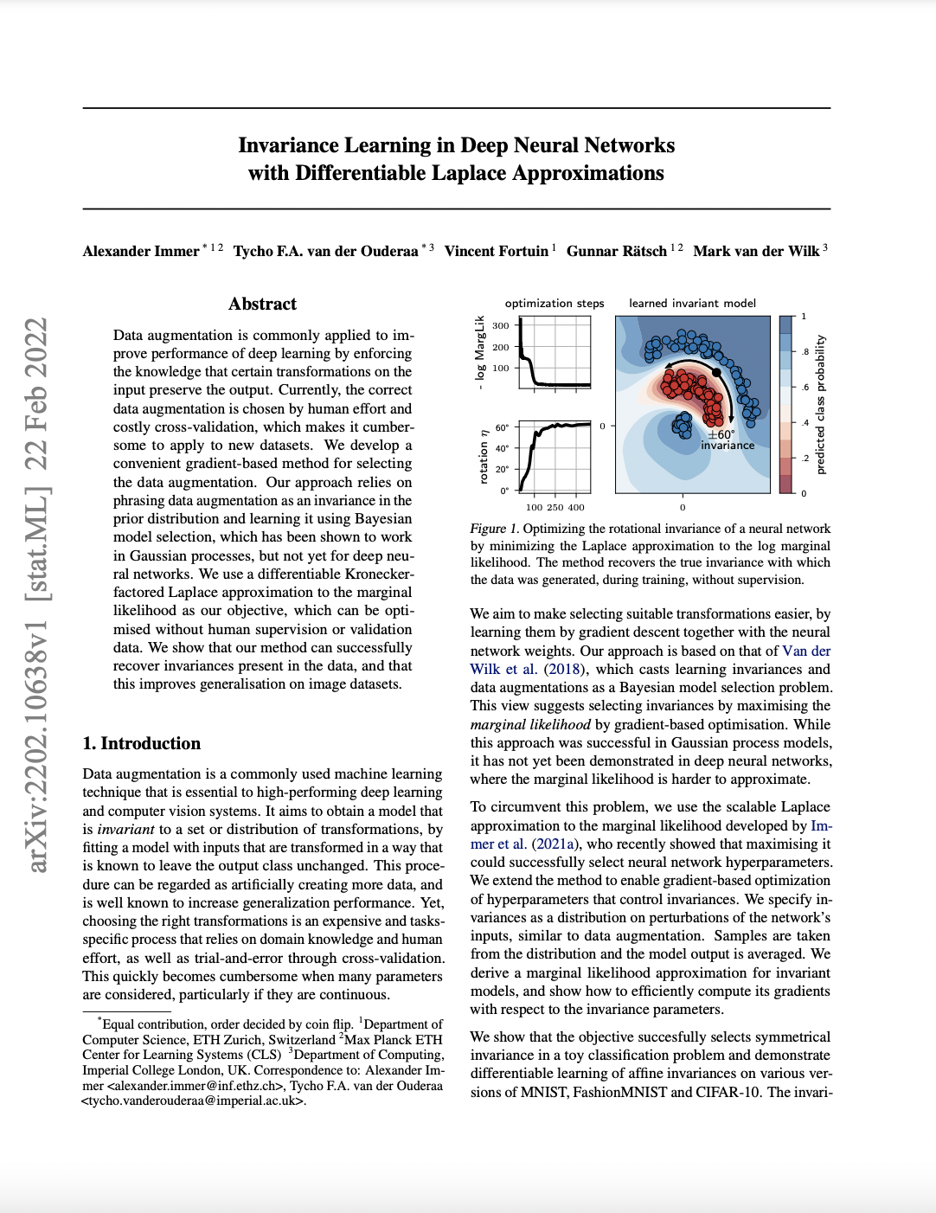
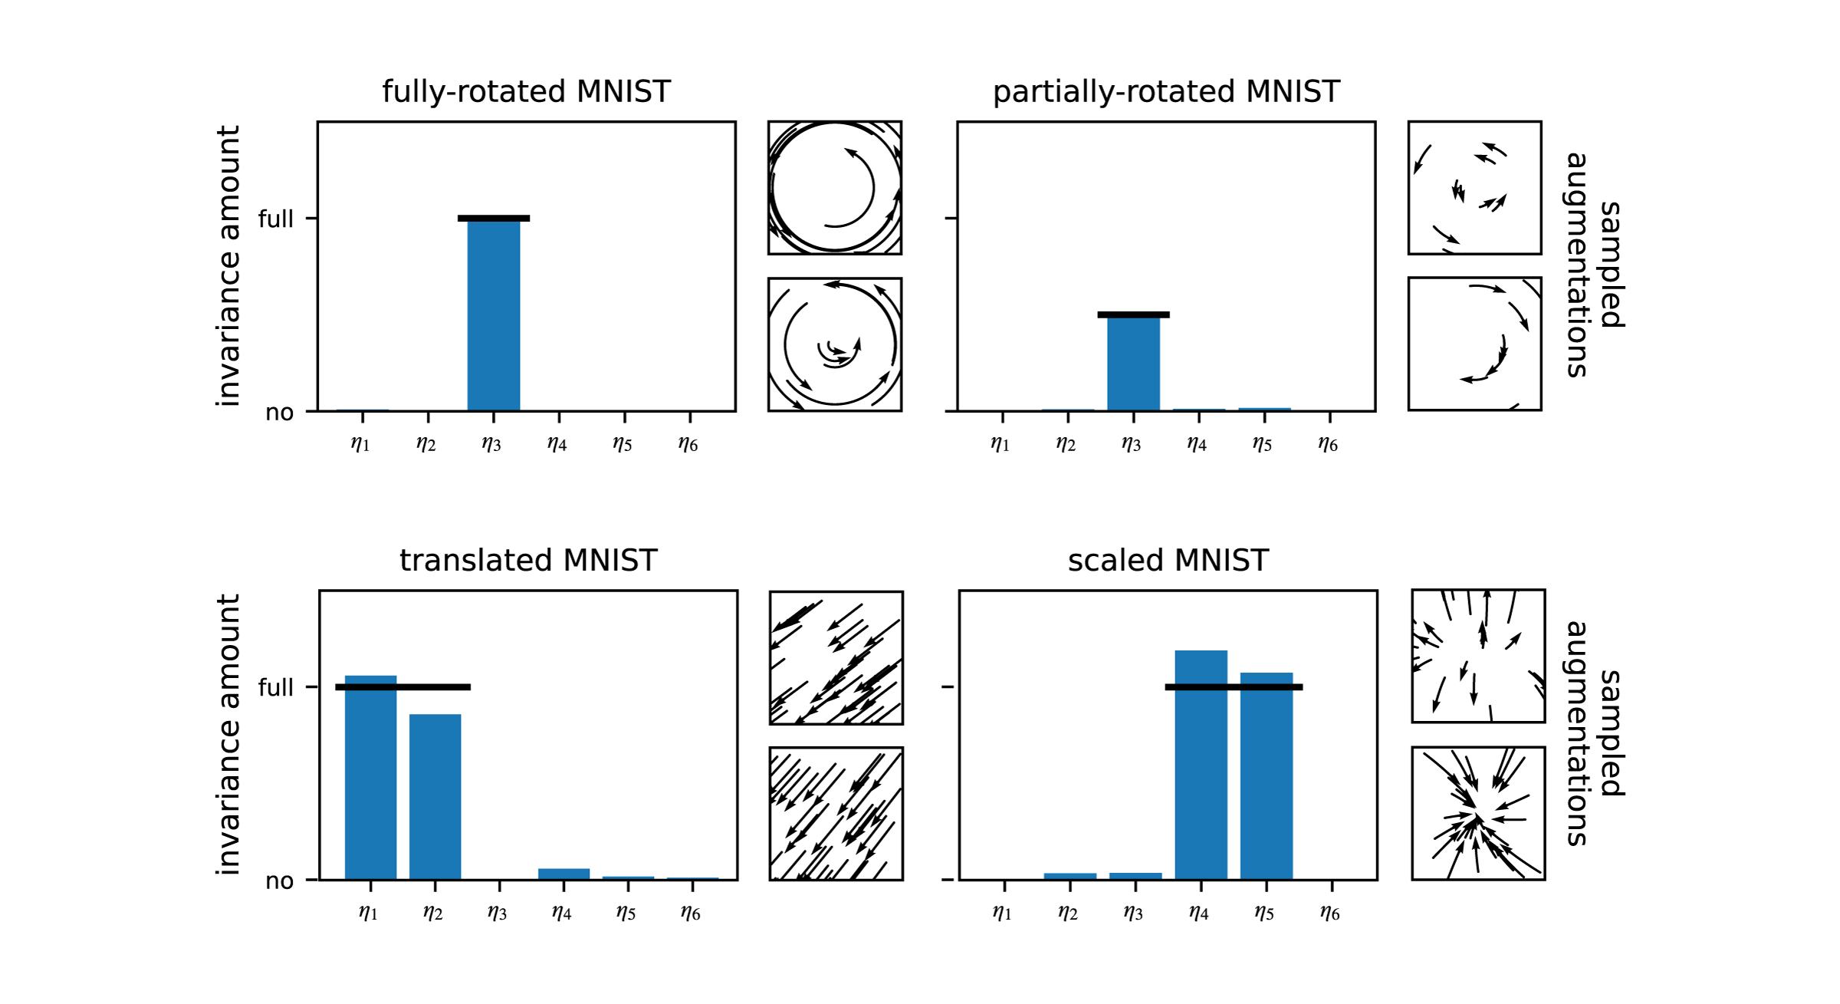
Invariance Learning in Deep Nets
[9] Invariance Learning in Deep Neural Networks with Differentiable Laplace Approximations Alexander Immer*, Tycho F.A. van der Ouderaa*, Vincent Fortuin, Gunnar Rätsch and Mark van der Wilk In NeurIPS 2022

Slide 32
What about learning equivariances?

Slide 33
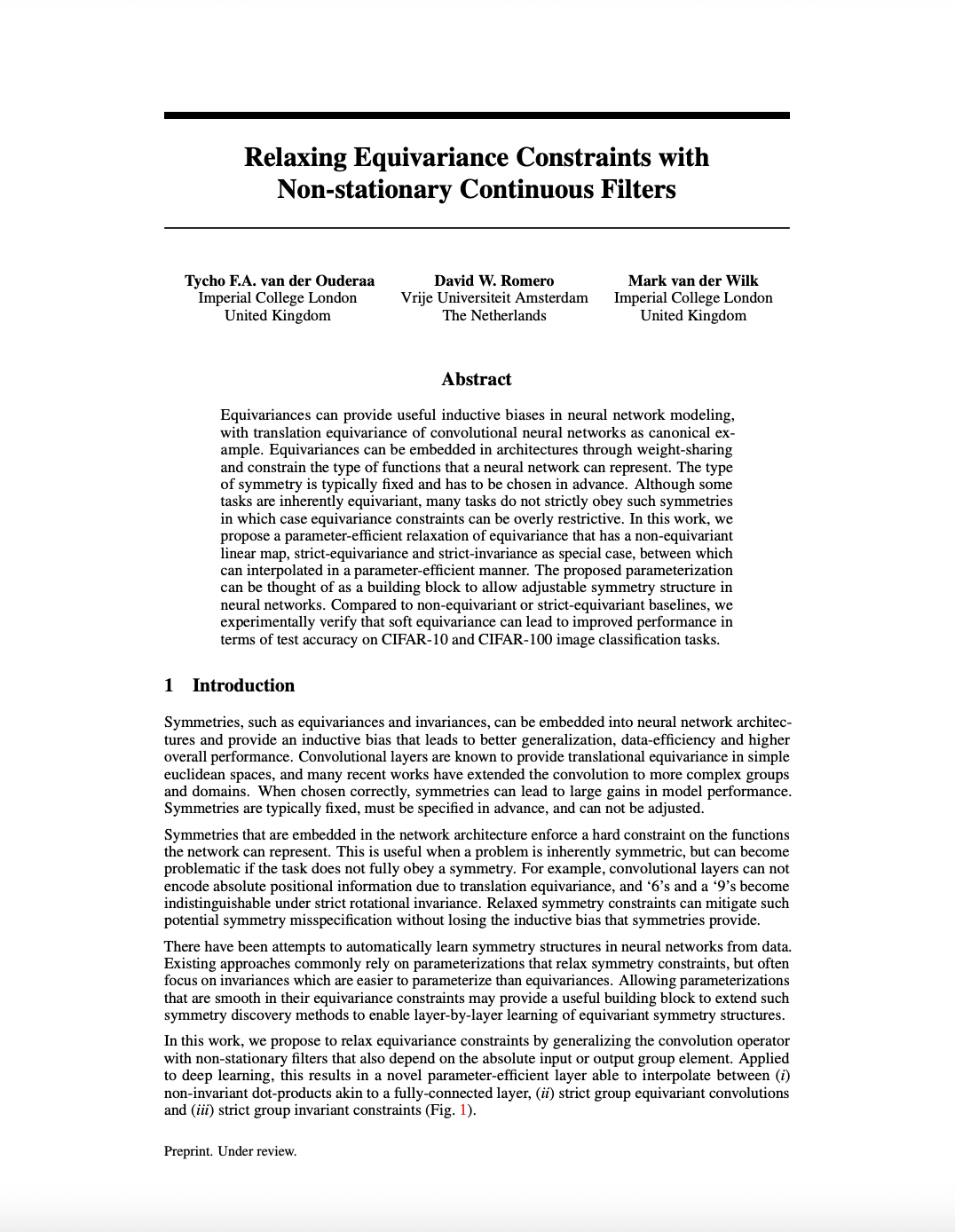
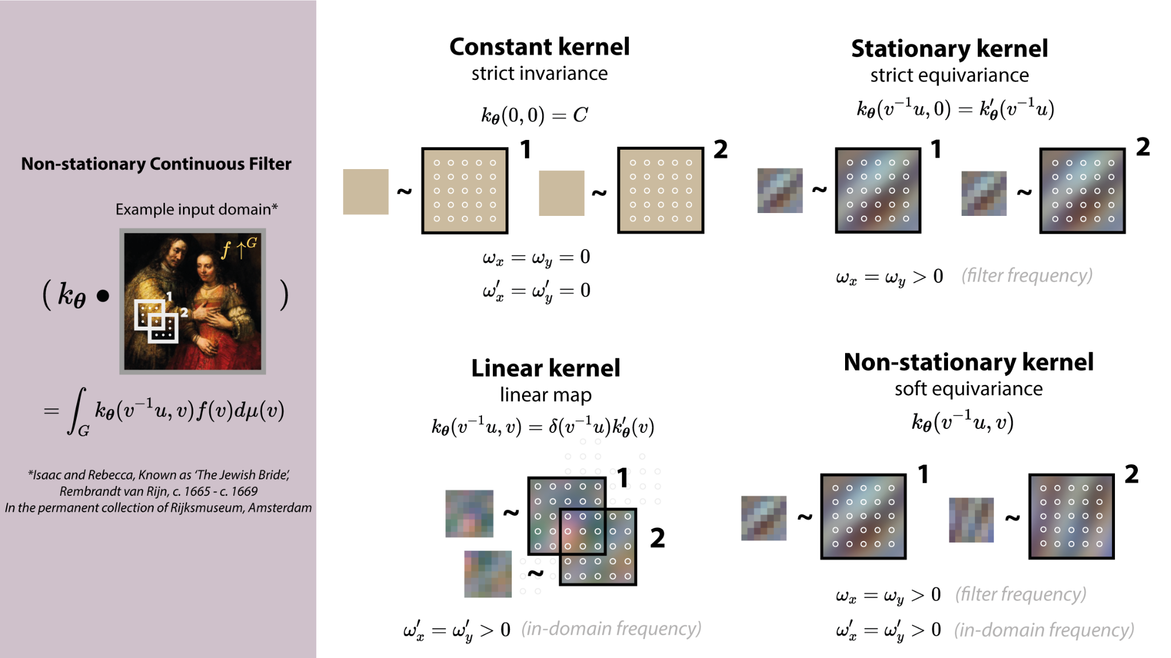
Relaxing equivariance constraints
[10] Relaxing Equivariance Constraints with Non-stationary Continuous Filters Tycho F.A. van der Ouderaa, David Romero and Mark van der Wilk In NeurIPS 2022

Slide 34
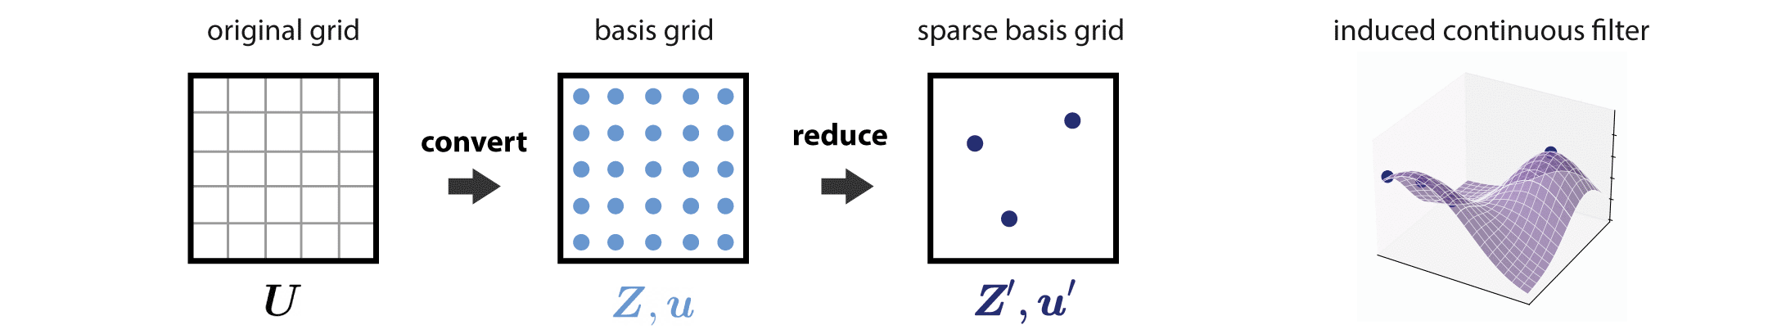
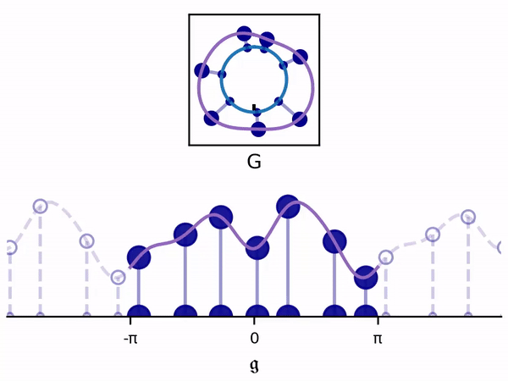
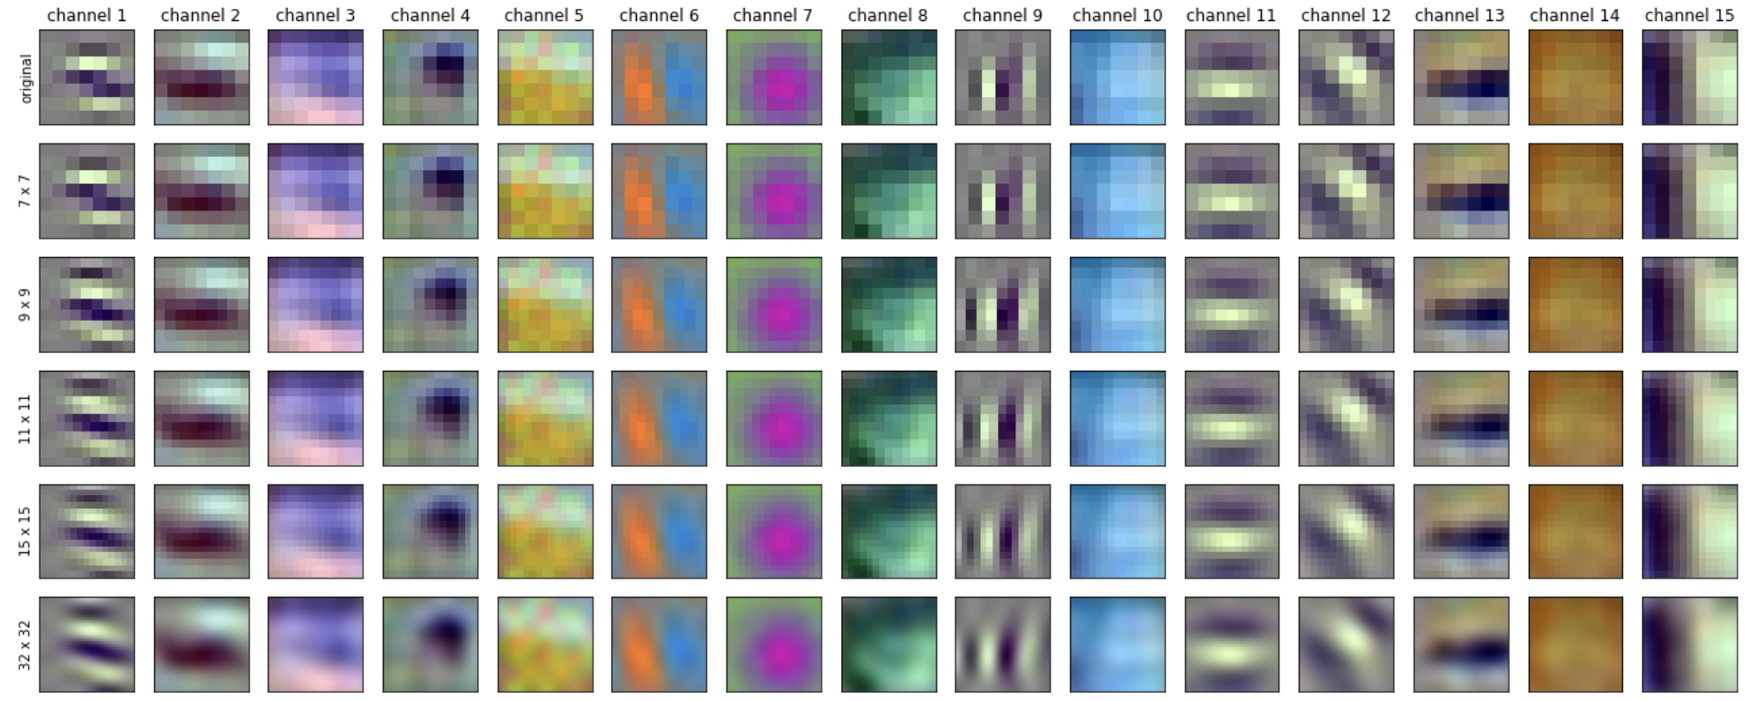
Continuous kernels
[11] Sparse Convolutions on Lie Groups Tycho F.A. van der Ouderaa and Mark van der Wilk In NeurIPS 2022 (Workshop on Symmetry and Geometry in Neural Representations)

Slide 35
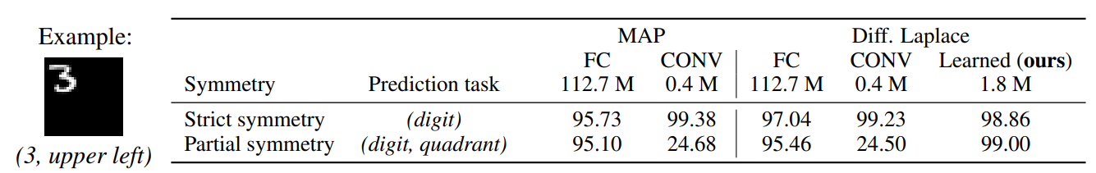
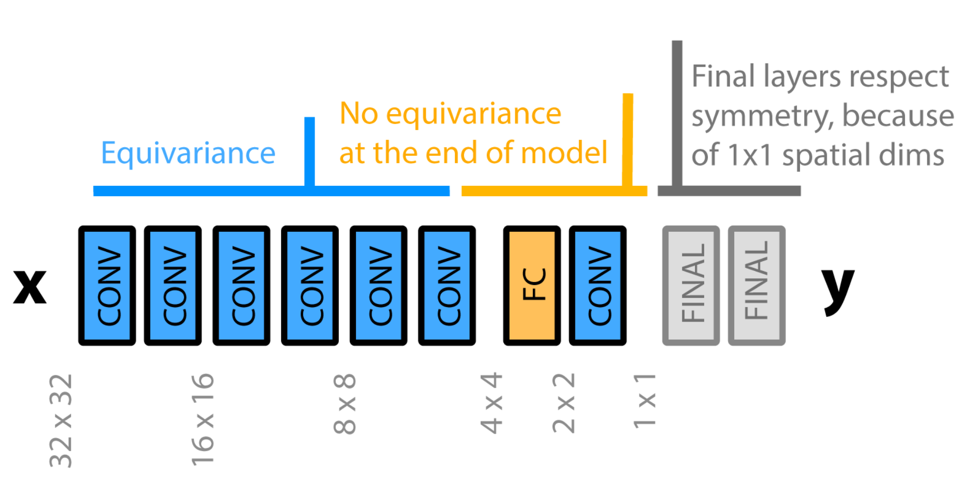
Learning layer-wise equivariances
MNIST
CIFAR-10
[12] Learning Layer-wise Equivariances Automatically using Gradients Tycho F.A. van der Ouderaa, Alexander Immer, Mark van der Wilk In NeurIPS 2023 (Awarded with spotlight)

Slide 36
Symmetries in Dynamical Systems

Slide 37
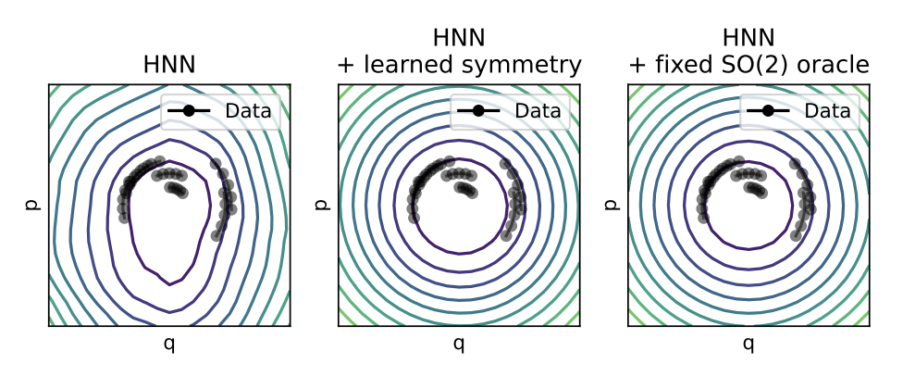
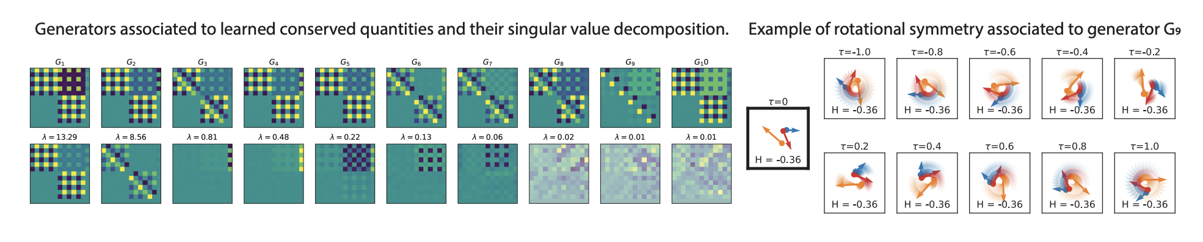
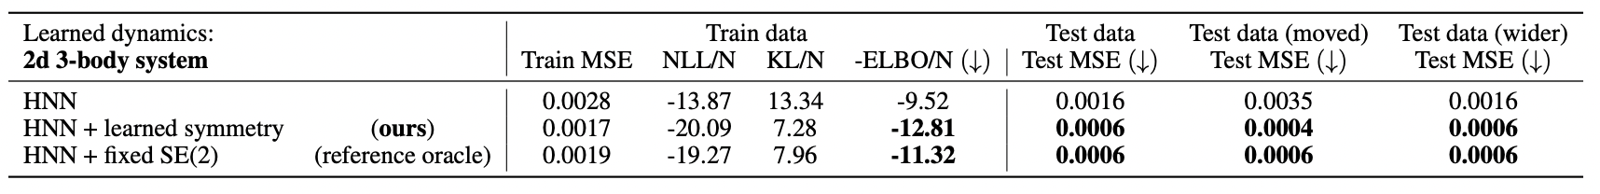
Noether's razor
Harmonic oscillator
Automatic symmetry discovery in dynamical systems
[13] Noether's razor Tycho F.A. van der Ouderaa, Mark van der Wilk, Pim de Haan
In submission.

Slide 38
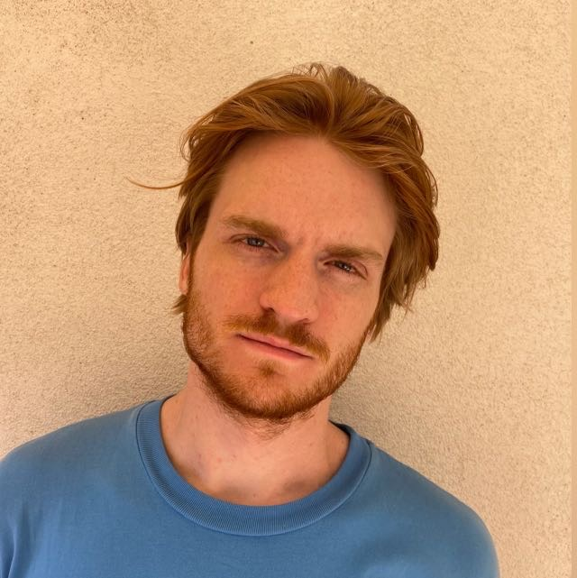




Bayesian Neural Model Selection for Symmetry Learning
Tycho van der Ouderaa
@tychovdo
tychovdo@gmail.com
Supervised by Dr. Mark van der Wilk
Postgraduate student (PhD) at:
Visiting researcher at:

